Slide 1
PROPOSAL
22.03.17
CAPSTONE DESIGN in GEOINFORMATIC ENGINEERING
12171218 박민규
12171206 장성준
12171210 정창현

Slide 2
Background and need
Goals and objectives
Project content and scope
Expected effects and utilization plan

Slide 3

1. Background and Need
Background
Uncomfortable information on the location of Complex lecture rooms and building facilities
After COVID-19, increasing In-person classes (offline classes)
Limitations of 2D map
Need
Repeated questions from freshmen year after year
Lack of data maps for student administration

Slide 4

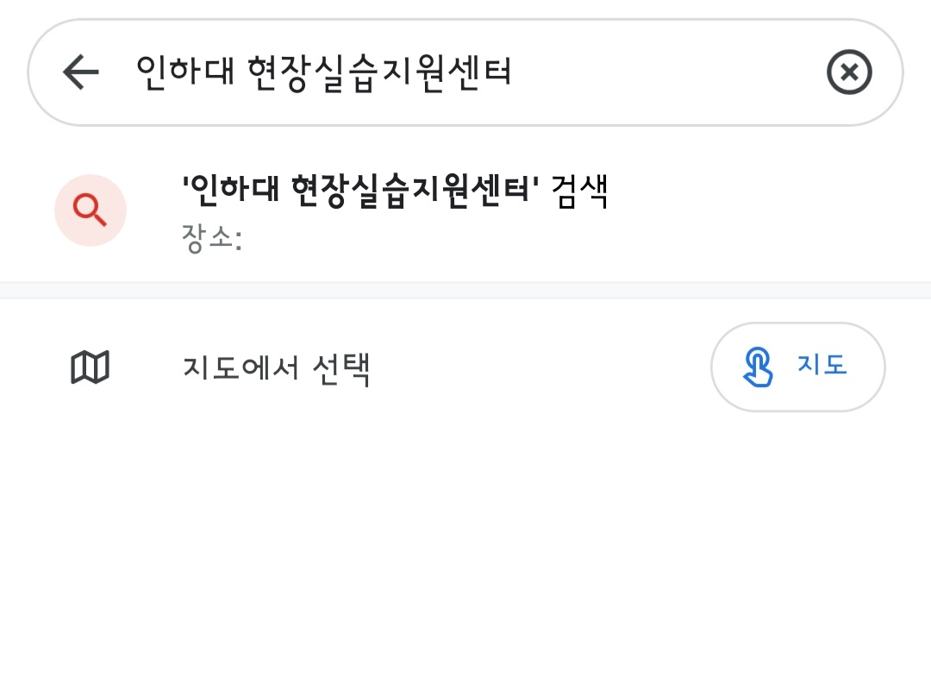
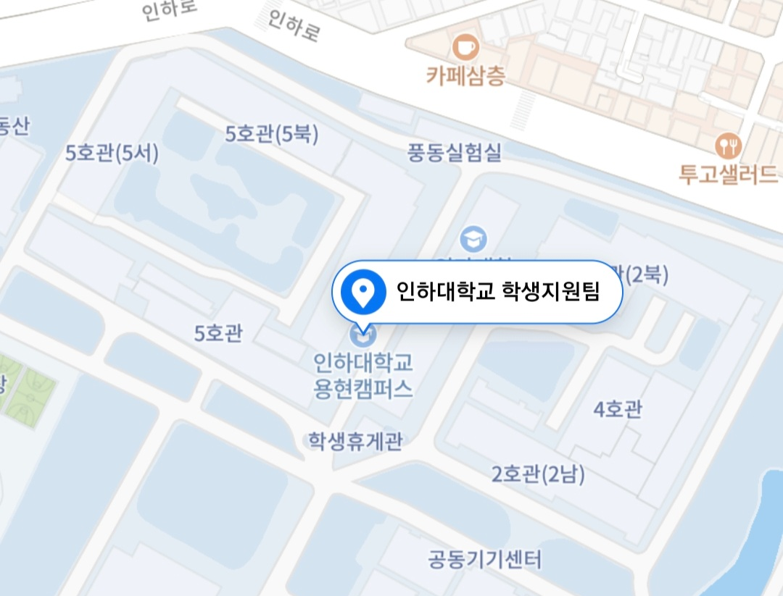

1. Background and Need
Background
Uncomfortable information on the location of Complex lecture rooms and building facilities
After COVID-19, increasing In-person classes (offline classes)
Limitations of 2D map
Need
Repeated questions from freshmen year after year
Lack of data maps for student administration

Slide 5
2. Goals and Objectives
Objectives
Convenient and intuitive guidance service for freshmen, all students, and outsiders who need directions
Goals
INHA campus AR navigation app development
If you have a cell phone, there’s no limit
Final output
INHA campus AR navigation, which guides you through AR when you enter destination on your cell phone, and helps you reach the wanted classroom from the inside of the building

Slide 6
3. Project content and scope
Technical status
Outdoor AR navigation
Kakao, Google, Naver labs, etc
use GPS
not only for pedestrians but also for cars
Indoor AR navigation
Naver labs
indoor positioning system – VL/AR

Slide 7


3. Project content and scope
Step-by-Step goal
UI Design and Layout
Acquire data
Outdoor Map API & Indoor Map
Geoinformatic Data
DB Implementation
Algorithms Implementation
Outdoor positioning algorithms – GPS
Indoor positioning algorithms - Beacon
Shortest-Route Algoritms
APP TEST

Slide 8






3. Project content and scope
Development Method
Use Unity 3D engine(AR Core), Android studio, Mapbox maps API & SDK , Vuforia SDK
Get the user’s current location from GPS using Mapbox SDK
Find the shortest distance (point to point)
Use Unity Route 3D visualization
Combine the Unity with Android Studio

Slide 9
3. Project content and scope
Time schedule
Week | Project schedule | Remarks
4 | Data acquisition & DB | Make Point
5-6 | Give shape to Unity AR 3D object And visualization with Mapbox SDK
7-8 | Combine Unity with Android Studio UI & Layout Design | Midterm presentation
9-11 | Acquisition of indoor positioning algorithms using beacons Implementation of shortest-distance algorithms with DB
12 | Data acquisition | Make Point
13 | Combine Unity with Android Studio / APP TEST | Add app
14 | Final presentation

Slide 10
4. Expected effects and utilization plan
Expected effects
Less difficulty finding directions for freshmen and students
Utilization plan
Post to the INHA Everytime community
Increase the number of buildings with beacons and indoor positioning to expand the range of availability
Make more point object ( smoking area, trash can, etc)

Slide 11
5. References
References
Outdoor AR
https://www.youtube.com/watch?v=F3pJb7YLAR0
https://blog.naver.com/ddism2686/222046338459
Indoor AR
https://www.koreascience.or.kr/article/CFKO201529368418569.pdf
https://www.naverlabs.com/storyDetail/112
https://blog.mapbox.com/indoor-navigation-in-ar-with-unity-6078afe9d958
http://koreascience.or.kr/article/JAKO201120661417634.pdf

